Slide 1
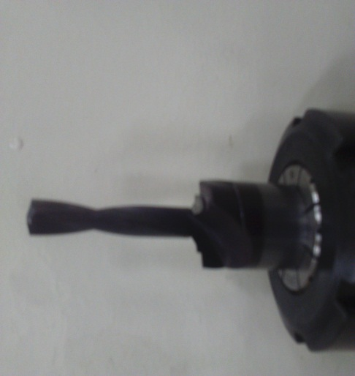
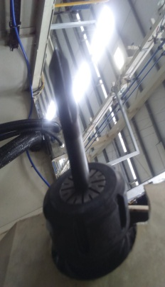
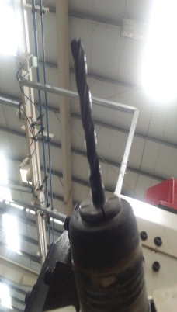
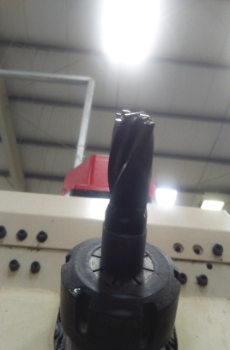
AHPL/QMS/FR/09/E
TPM CIRCLE NO :-
ACTIVITY
KK
QM
PM
JH
SHE
OT
DM
E&T
KAIZEN IDEA SHEET
TPM CIRCLE NAME:
LOSS NO. / STEP
DEPT :-
RESULT AREA
P
Q
A
C
D
S
M
CELL:- Oil Pump
CELL NAME :- A131 Body
MACHINE / STAGE :- Machining
OPERATION :- Drilling & Spot Face
KAIZEN THEME : To Improve Productivity.
IDEA :- Combination Tool Design.
Problem present status :- In A131 Body Separate Tool For Drilling , Chamfering & Spot face Machining.
COUNTERMEASURE:- New Combination Tool Design for Drilling, Chamfer & Spot face Machining.
BENCHMARK
Separate Tool
TARGET
Combine Tool
KAIZEN START
15.03.2017
TDC
28.04.2017
KAIZEN FINISH
30.05.2017
TEAM MEMBERS :
Dilip Phapale, Nilesh Khadke , Umesh Pimple
BENEFITS :-
Tool Cost Saved.
Before
After
KAIZEN SUSTENANCE
WHY - WHY ANALYSIS :-
Not Applicable
RESULT :-
Productivity Improve.
2) Tool Cost Saving.
WHAT TO DO:- Process not to Change.
HOW TO DO:- Tool list to be add in PCP.
FREQUENCY :- 1 time.
ROOT CAUSE :- .
REGISTRATION NO. & DATE : 30.05.2017
SCOPE & PLAN FOR HORIZONTAL DEPLOYMENT
REGISTERED BY :- Umesh Pimple
SR.
NO.
CELL
TARGET
RESPONSIBILITY
STATUS
MANAGER’S SIGN :- Dnyaneshwar Pawar
Nil
Rev. No.:01, Rev. Date:15.12.2016

